Slide 1










Team SIMM
Shayan S. Evan I. Joseph M. Emma M.
Player vs Player
Puzzle Landscaper
Immersive VR Experience
Music Driven RPG
Notes:
Evan

Slide 2

VR Music Experience
Concept 1
Notes:
Evan

Slide 3
The What |
The Why
Unity based Web 3D/VR Application
Immersive Audio-Visual experience
Audio Reactive visuals
Spatial Audio
A modern approach to music visualization.
A novel way for individuals to listen and appreciate music.
Current standards lack accessibility / flexibility.
Inspired by classic iterations.
WMP / WinAMP
Notes:
Evan | Joseph

Slide 4
Key Features
Audio Reactive visuals within an immersive 3D space Audio spectrometer Loudness / Positional
Control within a webpage; VR for more direct control.
Audio Processing with user adjustable parameters
Near universal browser support via WebXR.
Universal Icons / Accessible Controls via tool bar
Notes:
Emma

Slide 5
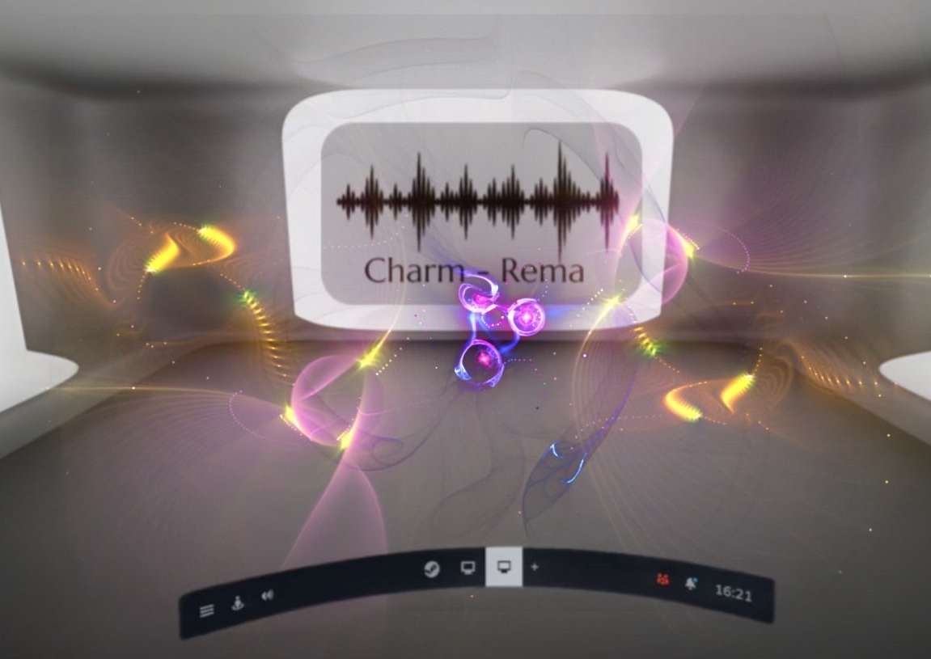
Sample showcase
Notes:
Emma

Slide 6

Vision
User will load into an empty room and be provided the option to upload their own audio files
User is placed in the center of the space with configurable visuals surrounding them.
Along with playback control, the user will be able to apply light audio processing to their music while within the environment.
Within the VR Space controls are tied to a menu attached to the user's controller mirroring the in-browser functionality
Notes:
Shayan

Slide 7
Technical Considerations / Further Scope
Visual Techniques: Unity / WebGL / three.js
Pre-Defined Procedural Generation ML Based??
Audio Processing:
Content Management System Playlists / “Projects”
Richer audio control Live Mixing Advanced Processing
MIDI input
Notes:
Joseph

Slide 8
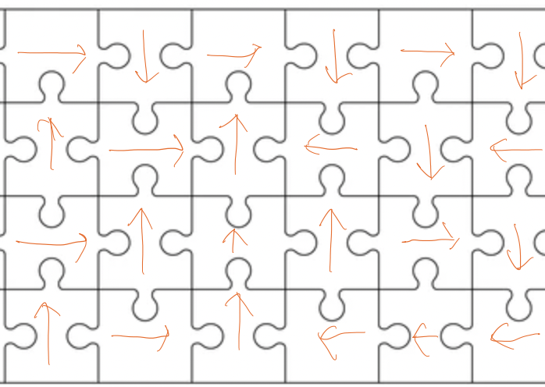
PvP Puzzle Landscaper
Concept 2
Board game style multiplayer game
Key concept is players lack control and move with each turn while the board remains modifiable
During each players’ turn they can manipulate and move board pieces to their benefit/other players detriment
Survival is key; Game ends when on
Notes:
Shayan

Slide 9
PvP Puzzle Landscaper Cont.
2D or 3D within
Multiplayer via Mirror Networking for Unity Different game modes:
PvE : Work as a team PvP : Last player standing
Scoring system to determine standing based on performance

Slide 10
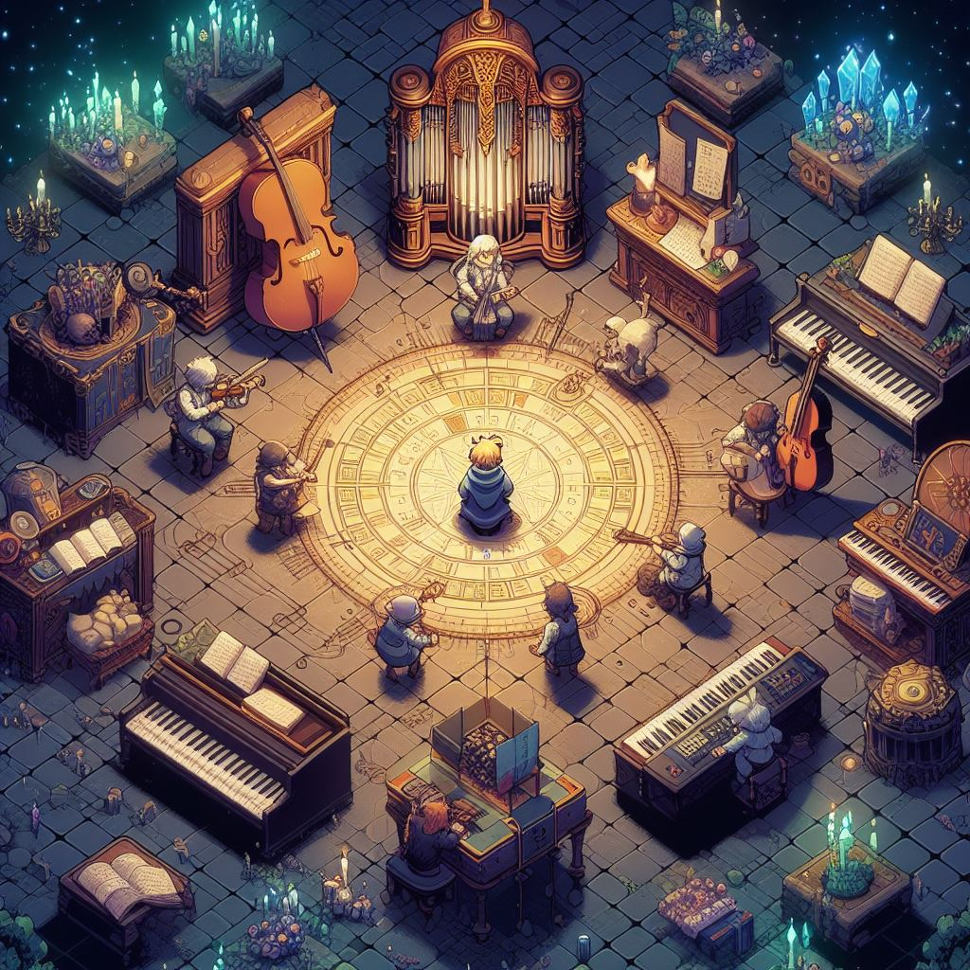
Music Driven RPG
Concept 3
A top-down RPG, where music is the key to unlocking your magical powers.
Explore this world infused of musical charm, filled enchanted forests and ancient ruins as you collect scattered musical notes hidden throughout the world.
Collect notes can be combined to be used to unleash spells, summon allies, and enhance your skills to help you defeat your enemies.
Notes:
Emma

Slide 11
Music Driven RPG
Game Engine: Godot
Languages: GDScript (Godot’s built-in language) for game logics
Visual design: Krita
Notes:
Emma

